Slide 1
MACHINE LEARNING SEMESTER PROJECT
Retail Shoplifting Detection
Using Pose-Based Feature Engineering and Classical Machine Learning
Your Name
Course Name
Department
Instructor Name
Date

Slide 2



Why This Project?
Retail stores rely heavily on CCTV cameras for monitoring theft-related activities. Manually watching surveillance footage is time-consuming and prone to human error. Shoplifting is often identified through body and hand movements — especially when a person picks up an item and tries to hide it in a pocket, jacket, or near the body.
FROM FOOTAGE TO DECISION
CCTV Clip
This project builds a machine learning system that classifies short retail CCTV clips as:
THEFT
NO THEFT
ML Model
Theft / No Theft
Retail Shoplifting Detection — ML Semester Project
2

Slide 3


Problem Statement
Task: Classify trimmed retail CCTV clips into two classes.
Input: Short CCTV clip of a person interacting with a shelf Output: Theft or No Theft
Theft Behavior
No-Theft Behavior
Item hidden in pocket
Item hidden under jacket
Item hidden near belly
Item hidden inside front jacket / zip area
Person picks item
Looks at item
Keeps item visible
Walks normally
Class | Description
Theft | Item is concealed near body, pocket, or jacket
No Theft | Item remains visible or normal handling occurs
Retail Shoplifting Detection — ML Semester Project
3

Slide 4
Dataset
The dataset contains two classes of CCTV clips, gathered with different camera angles and clip lengths.
970
966
1936
features_df["class_name"].value_counts()
Theft Clips
No-Theft Clips
Total Clips
theft 970
no_theft 966
Dataset Properties
Different CCTV angles
theft
970
Different clip lengths
no_theft
966
One target person per clip
Polygon crop / masking applied
Background and other people blacked out
Retail Shoplifting Detection — ML Semester Project
4

Slide 5
Why Classical Machine Learning?
Deep learning models such as CNN, LSTM, and 3D CNN usually need larger datasets and more compute. With ~1936 clips, a feature-based ML approach is more suitable — extracting meaningful body-movement features from videos instead of training directly on raw frames.
Final Approach
Video
→
Pose Landmarks
→
Motion Features
→
ML Classifier
Models Used
Logistic Regression
SVM
Random Forest
 | Deep Learning | Classical ML
Dataset size | Needs large dataset | Works with small / medium dataset
Feature learning | Learns features automatically | Uses engineered features
Explainability | Less explainable | More explainable
Compute cost | More computation | Easier to train
Retail Shoplifting Detection — ML Semester Project
5

Slide 6







Proposed Pipeline
→
→
→
→
→
→
→
Raw CCTV Clip
Polygon Crop /
Person Isolation
Sample 30
Frames
MediaPipe Pose
Extraction
Feature
Engineering
pose_features
.csv
Train ML
Models
Predict Theft /
No Theft
An end-to-end flow: from raw footage to a Theft / No-Theft decision, via pose-based feature engineering.
Retail Shoplifting Detection — ML Semester Project
Retail Shoplifting Detection — ML Semester Project
6
6

Slide 7
Frame Sampling from Videos
Videos have different lengths, so each clip was converted into a fixed representation by sampling 30 frames at equal intervals.
Why Sampling Is Needed
Clips are variable length
Model needs fixed-size input
Important movement happens across a sequence
Sampling captures start, middle, and end of action
Theft Clip — Sampled Frames
No-Theft Clip — Sampled Frames
Retail Shoplifting Detection — ML Semester Project
7

Slide 8
Pose Landmark Extraction
MediaPipe Pose Landmarker was used to extract human body landmarks from each sampled frame.
Pose Skeleton (Illustrative)
Key Landmarks Used
Left / right shoulder
Left / right elbow
Left / right wrist
Left / right hip
These landmarks matter because shoplifting behavior often involves:
Hand moving toward belly
Hand moving toward pocket
Arm bending
Body turning
One side becoming hidden
Joint markers indicate tracked landmarks (shoulders, elbows, wrists, hips)
Retail Shoplifting Detection — ML Semester Project
8

Slide 9
Feature Engineering
Each video was converted into one row of numerical features. Theft usually involves hand movement toward the body, jacket, belly, or pocket — so features were designed to capture these movement patterns.
Feature Group | Why Useful
Wrist-to-belly distance | Detects hand moving near jacket / belly
Wrist-to-hip distance | Detects hand moving near pocket
Wrist speed | Detects sudden concealment movement
Elbow angle | Captures arm bending
Torso angle | Captures body turning
Landmark / side visibility | Captures occlusion / side hiding
Retail Shoplifting Detection — ML Semester Project
9

Slide 10
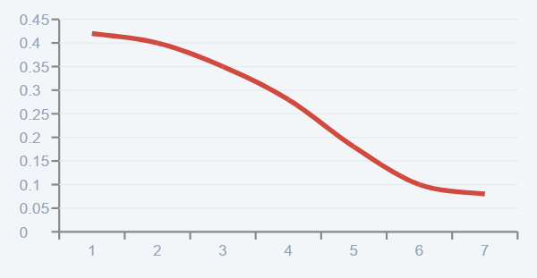
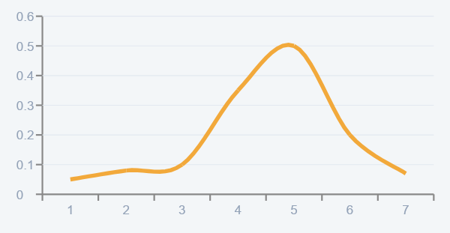
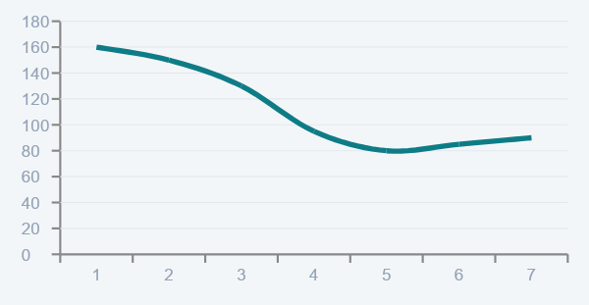
Movement Visualization
The system visualizes movement patterns over time to interpret suspicious behavior.
Wrist-to-Belly Distance
Wrist Speed
Elbow Angle
Distance decreases sharply — the hand is moving closer to the body.
A speed spike signals sudden hand movement.
Angle drops as the arm bends inward.
Example: a sudden wrist movement and a drop in wrist-to-belly distance occur as the person turns and moves a hand near the body.
Retail Shoplifting Detection — ML Semester Project
10

Slide 11

Pose Quality Filtering
Some videos had weak pose detection due to camera angle, occlusion, or partial visibility. A pose detection ratio was calculated to filter low-quality clips.
pose_detection_ratio = valid pose frames / total sampled frames
Final Threshold
0.3
Threshold | Theft | No Theft | Total
0.3 | 966 | 950 | 1916
0.4 | 960 | 947 | 1907
0.5 | 957 | 942 | 1899
0.6 | 954 | 940 | 1894
Preserved more no-theft videos and reduced dataset imbalance.
Retail Shoplifting Detection — ML Semester Project
11

Slide 12



Machine Learning Models
Logistic Regression
SVM
Random Forest
Baseline model
Main classifier for non-linear separation
Feature importance & comparison
Preprocessing
FINAL MODEL
Missing values handled using median imputation
SVM (RBF Kernel)
Features scaled using StandardScaler for SVM and Logistic Regression
C = 5
gamma = scale
class_weight = balanced
Class imbalance handled using class_weight="balanced"
Retail Shoplifting Detection — ML Semester Project
12

Slide 13
Initial Model Comparison
Using 0.3 pose detection threshold and a single train-test split:
Model | Accuracy | Bal. Acc. | Theft Recall | No-Theft Recall
Logistic Regression | 67.3% | 66.8% | 70% | 64%
SVM | 75.0% | 73.5% | 83% | 64%
Random Forest | 78.8% | 76.8% | 90% | 64%
Random Forest — Confusion Matrix
14
8
Random Forest performed well on a single split, but cross-validation was needed for a more reliable evaluation.
3
27
Predicted: No Theft Predicted: Theft
3 theft clips were missed
8 no-theft clips wrongly flagged as theft
Retail Shoplifting Detection — ML Semester Project
13

Slide 14
5-Fold Cross-Validation Results
Model | Accuracy | Bal. Acc. | Theft Recall | No-Theft Recall
Logistic Regression | 71.9% | 70.7% | 77.1% | 64.2%
SVM | 80.9% | 79.7% | 86.6% | 72.7%
Random Forest | 76.2% | 74.1% | 86.6% | 61.5%
SVM performed best overall
— it had the best balance between theft detection and no-theft detection.
Retail Shoplifting Detection — ML Semester Project
14

Slide 15

SVM Hyperparameter Tuning
GridSearchCV was used to tune the SVM model.
C = 5
gamma = scale
kernel = rbf
Metric | Result
Accuracy | 83.2% ± 6.0%
Balanced Accuracy | 82.4% ± 6.3%
Theft Precision | 84.5% ± 5.3%
Theft Recall | 87.3% ± 4.8%
Theft F1-score | 85.9% ± 4.9%
No-Theft Recall | 77.5% ± 8.3%
Tuned Model
83.2%
Accuracy
Final performance result of this project
Retail Shoplifting Detection — ML Semester Project
15

Slide 16
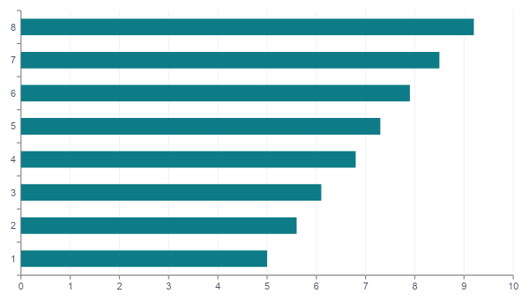
Important Features
Random Forest feature importance reveals which signals drove predictions.
MODEL LEARNED
Hand moving near pocket
Hand moving near belly / jacket
Body turning
Side visibility change
Arm bending
This explainability is a key advantage of the classical ML approach.
Retail Shoplifting Detection — ML Semester Project
16

Slide 17

Video-Level Prediction Demo
The final model runs end-to-end on real videos:
Input Video
→
Extract Frames
→
Pose Landmarks
→
Compute Features
→
Predict
→
Overlay Result
Demo 1
Demo 2
Correct Theft Prediction
Correct No-Theft Prediction
Output overlays pose skeleton, wrist movement trail, prediction label, and confidence on the video.
Retail Shoplifting Detection — ML Semester Project
17

Slide 18
Example Prediction
The model predicted this clip as no-theft with high confidence. A pose detection ratio of 1.0 means pose was detected successfully in every sampled frame.
NO THEFT
Prediction
No Theft
Confidence
0.925
Theft Probability
0.075
No-Theft Probability
0.925
Pose Detection Ratio
1.0
Retail Shoplifting Detection — ML Semester Project
18

Slide 19

Error Analysis
Some false positives and false negatives occurred.
False Positive
False Negative
Actual no-theft clip predicted as theft
Actual theft clip predicted as no-theft
Possible reasons:
Possible reasons:
Normal customer moves hand close to body
Person turns sideways
Object is held near torso
Pose resembles concealment
Concealment is subtle
Body is partially visible
Pose detection misses wrist / hip
Camera angle hides important movement
Retail Shoplifting Detection — ML Semester Project
19

Slide 20

Limitations and Future Work
Limitations
Future Work
Small dataset
Different CCTV angles
Some partial body visibility
No direct item tracking
Trained on trimmed clips, not full surveillance video
Some normal actions look similar to concealment
Add more no-theft videos
Add object visibility features
Detect exact concealment moment
Use longer CCTV videos
Build a web demo interface
Try XGBoost / LightGBM
Add confidence threshold for human review
Retail Shoplifting Detection — ML Semester Project
21

Slide 21
Conclusion
This project developed a pose-based ML system for classifying retail CCTV clips as theft or no-theft. Instead of deep learning on raw video frames, the system extracted pose landmarks and engineered motion features.
83.2%
82.4%
Accuracy
Balanced Accuracy
87.3%
77.5%
Theft Recall
No-Theft Recall
Best Model: Tuned SVM (RBF Kernel)
The results show that pose-based motion features can effectively capture suspicious concealment behavior, and can be used as a human-review support tool in retail surveillance.
Retail Shoplifting Detection — ML Semester Project
22

